Slide 1
Real-Time ATM Monitoring System using Spring Boot and Azure
Name:- Sarvesh Zade
Cognizant Id:-2388084
Cohort Code:-INTIOT25JPE001

Slide 2
Agenda
Project Overview
Technologies Used
System Architecture
Backend (Spring Boot)
Azure Integration
Frontend Integration
Demo Screenshots
Conclusion

Slide 3
Project Description
Objective:-
Develop a real-time ATM machine monitoring system that collects data from IOT sensors, processes the data ,and displays the latest readings on a web application
Core Components:-
Spring Boot for backend processing
Azure IOT Hub for device communication
Azure Service Bus and Stream Analytics for message routing and processing
Tailwind CSS based frontend for UI

Slide 4
Technologies Used
Backend:- Spring Boot
Cloud Services:- Azure IOT Hub , Azure Service Bus, Stream Analytics, Azure SQL Database.
Frontend:- HTML ,Tailwind CSS , Javascript
Tools:- Postman, Eclipse, VS-code, Azure Portal

Slide 5
System Architecture
WorkFlow:-
IOT sensors send temperature and cash status to Azure IOT hub.
Temperature data -> Stream Analytics -> Azure SQL DB
Cash Data -> Azure Service Bus -> Spring Boot Listener -> Azure SQL DB
Spring Boot fetches and displays latest data on UI

Slide 6
Azure Setup
Created IOT Hub
Registered two devices:
temperature-device
cashflow-device
Obtained device connection strings for communication
Created SQL Database with following tables
ATM_details
CashFlow
Location
Temperature
Users

Slide 7
Message Routing
Routing Configuration:
Temperature Device:
Routed to Azure Stream Analytics
Cashflow Device:
Routed to Azure Service Bus Topic
Spring Boot Listener processes the data

Slide 8
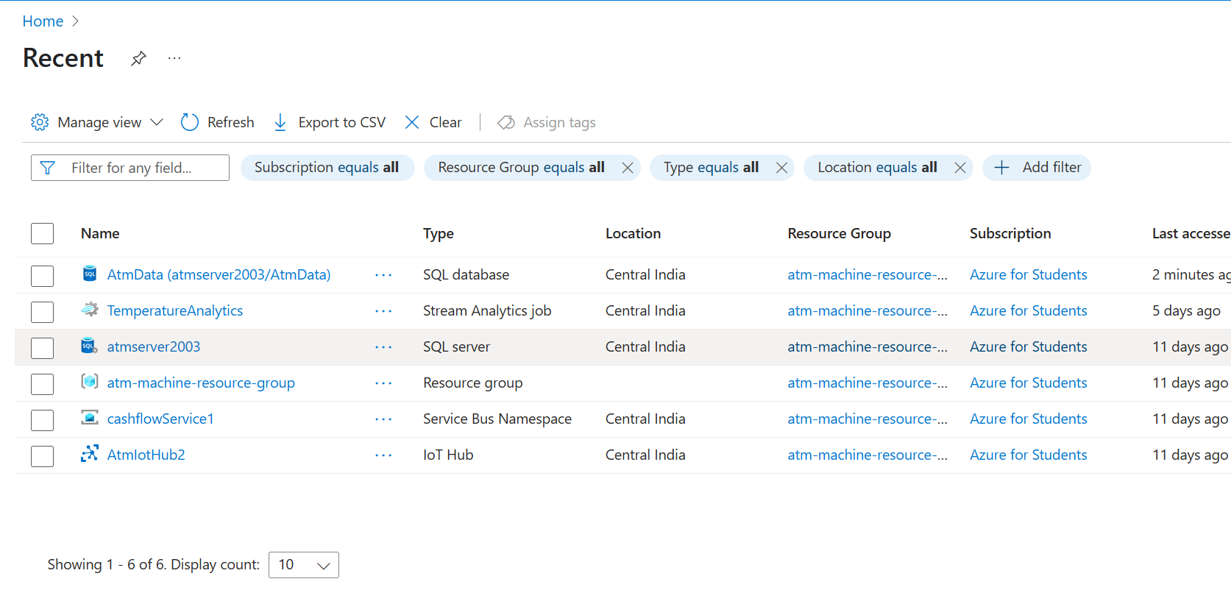

Slide 9
Spring Boot Backend
Overview:-
The Backend of the project is built using Spring Boot. It handles the business logic, communication with Azure Services, and APIs for frontend interaction. The architecture follows a modular structure with clearly separated layers.
Different Layers which are used in the project is:-
Entity Layer
Controller Layer
Repository Layer
Service Layer

Slide 10
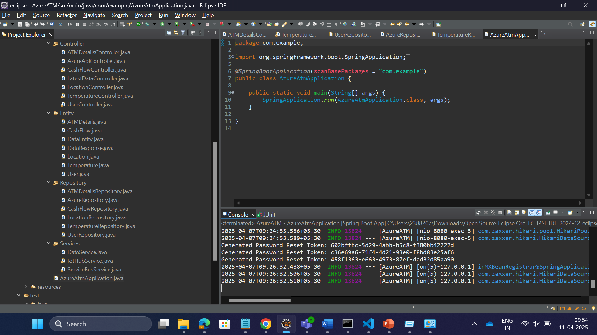

Slide 11
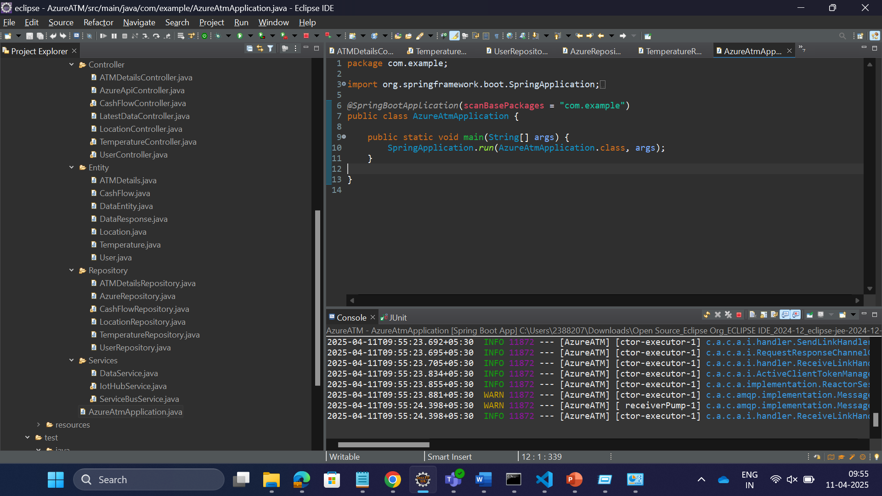

Slide 12
Frontend UI
Tailwind CSS-Based UI:
Registration Screen:-
You need to register your self as a technician or as admin.
You need to enter user name ,email id, mobile number , role and password to register your self.
There are many constraints like the password should be same for both password and confirm password.

Slide 13
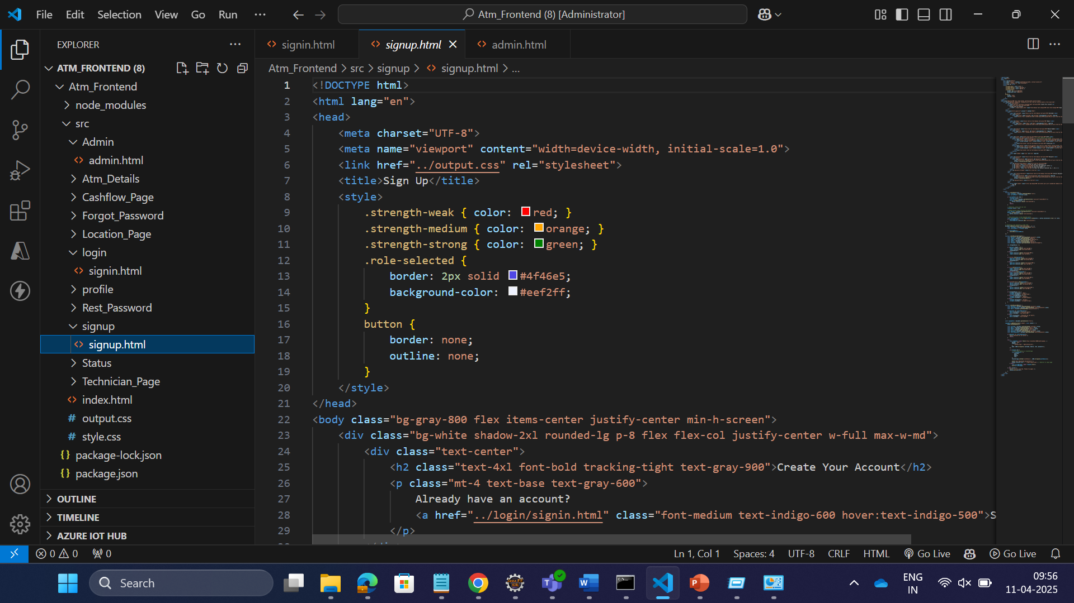

Slide 14
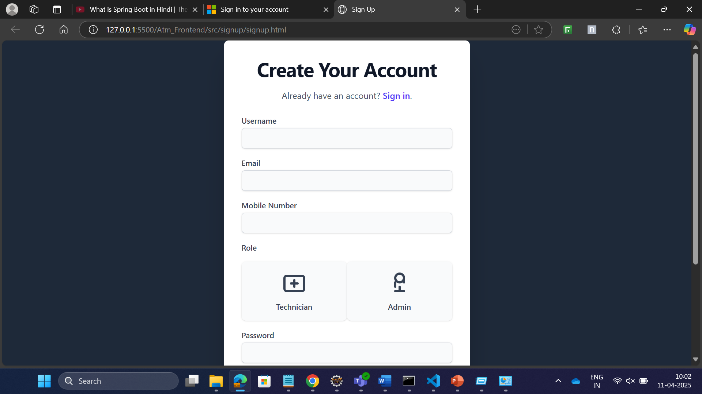

Slide 15
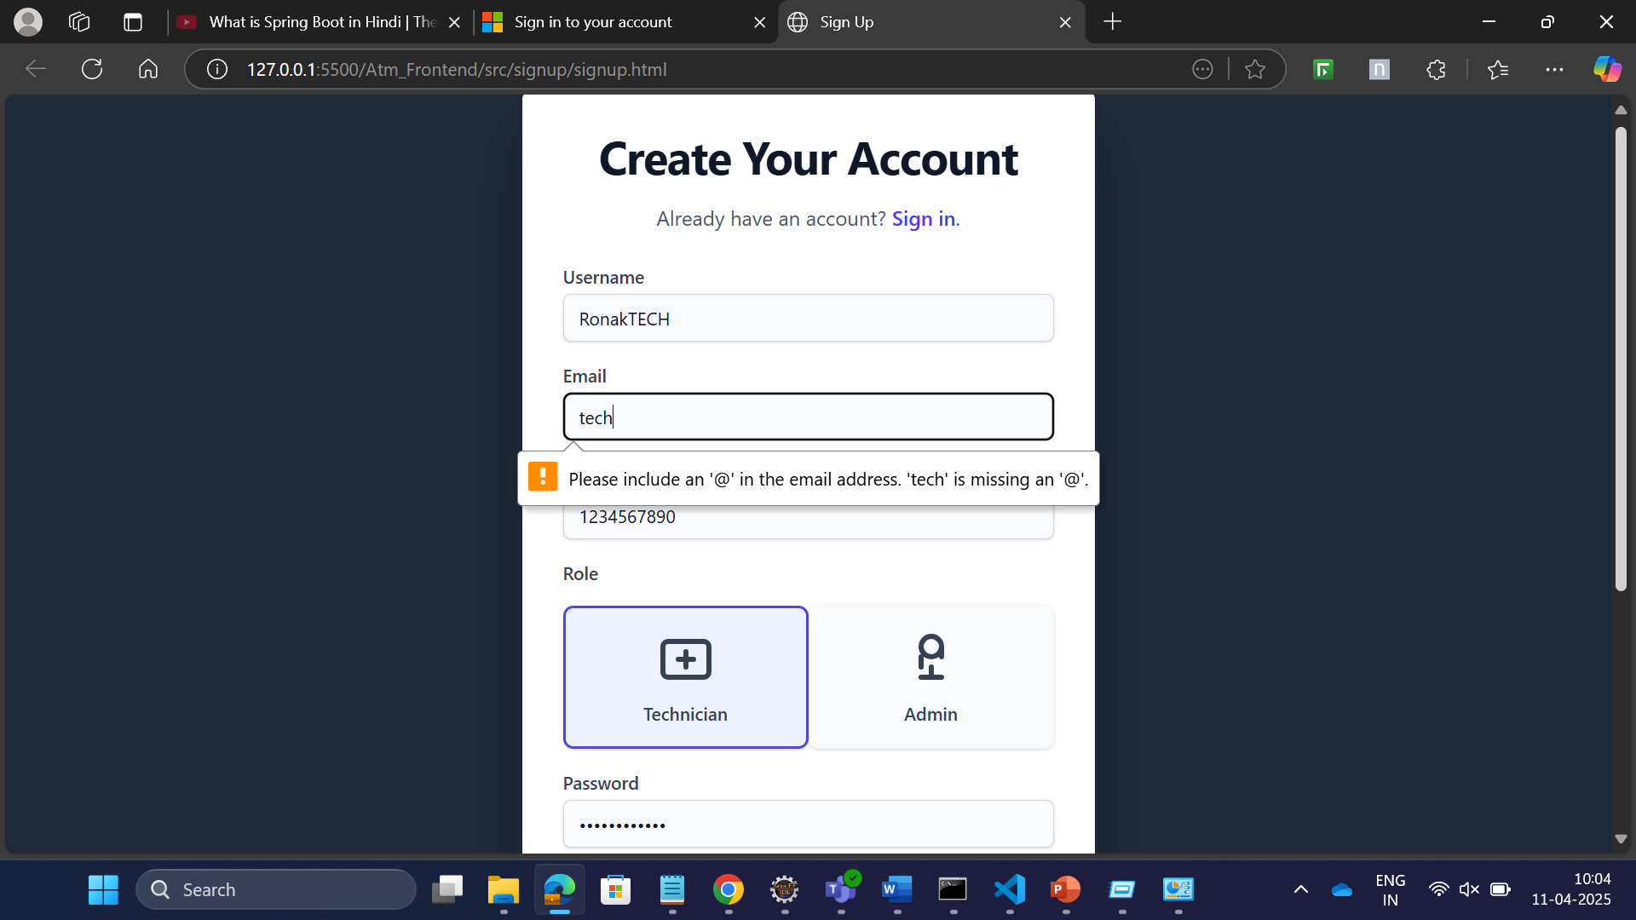

Slide 16
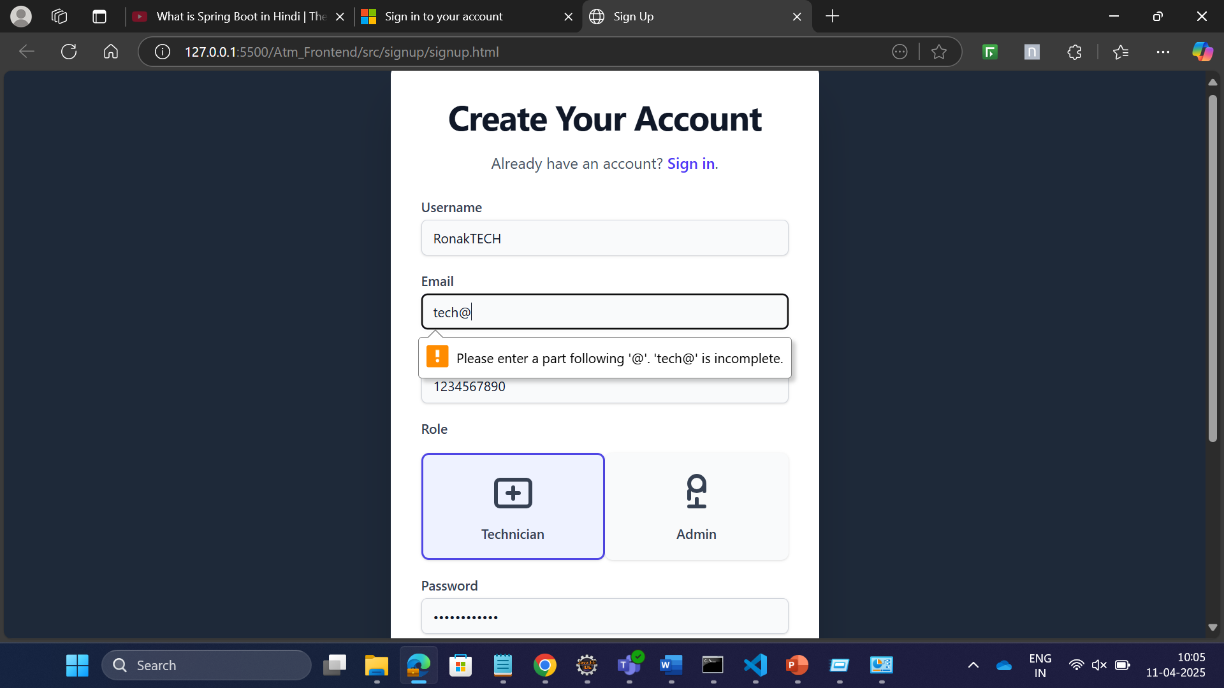

Slide 17
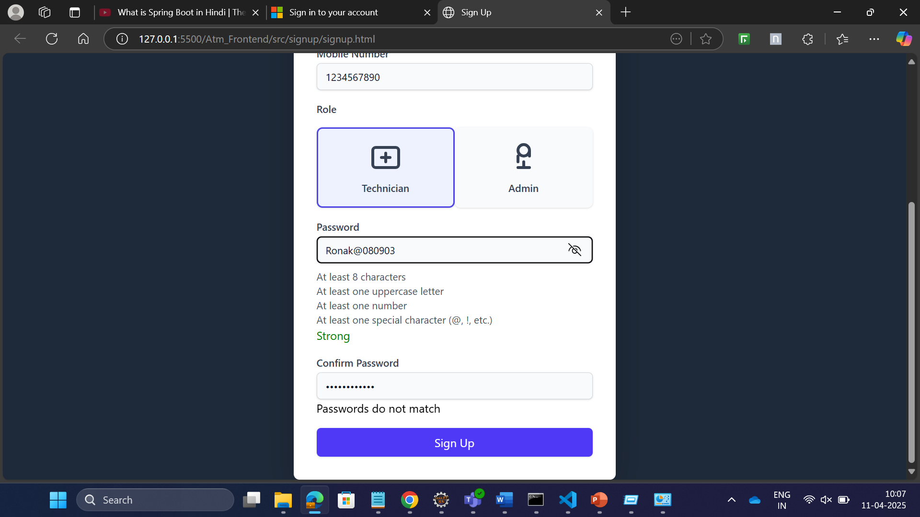

Slide 18
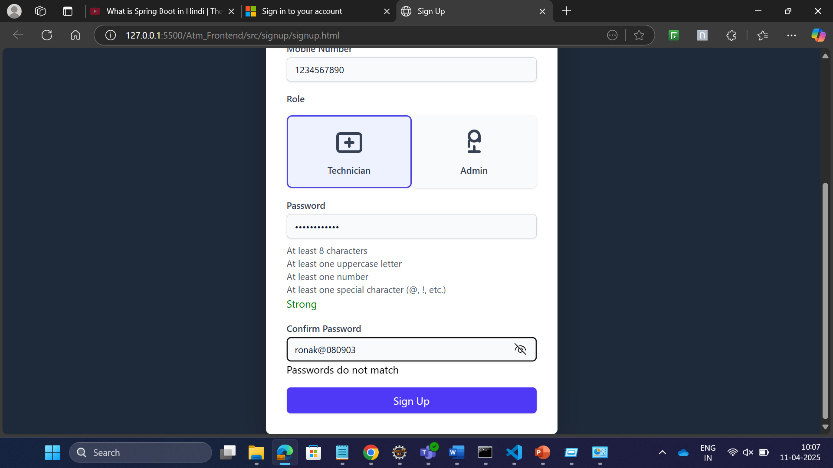

Slide 19
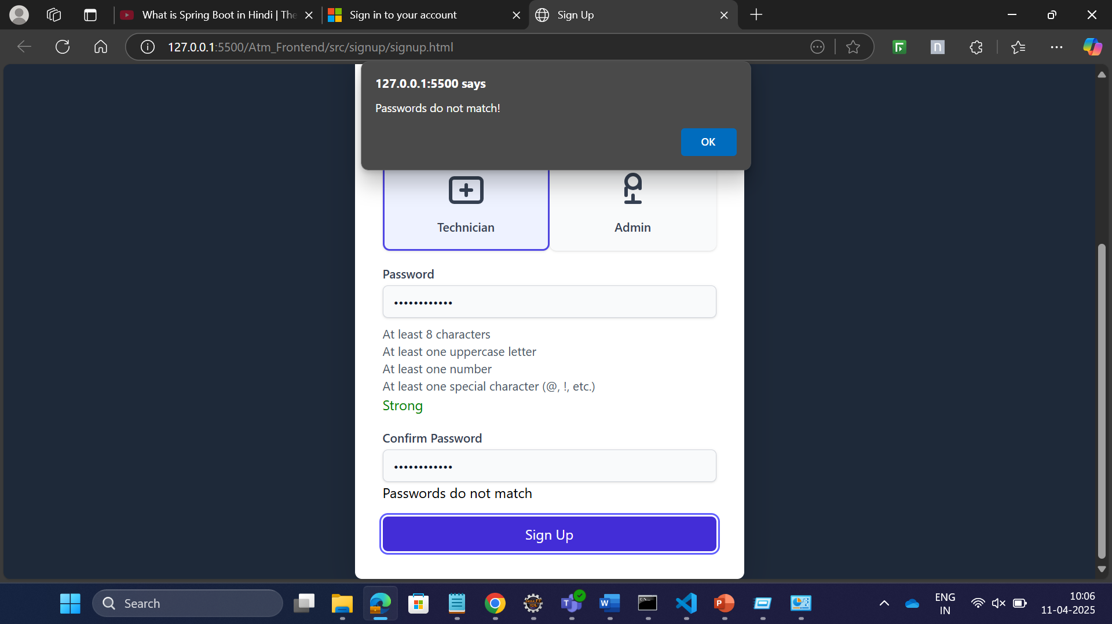

Slide 20
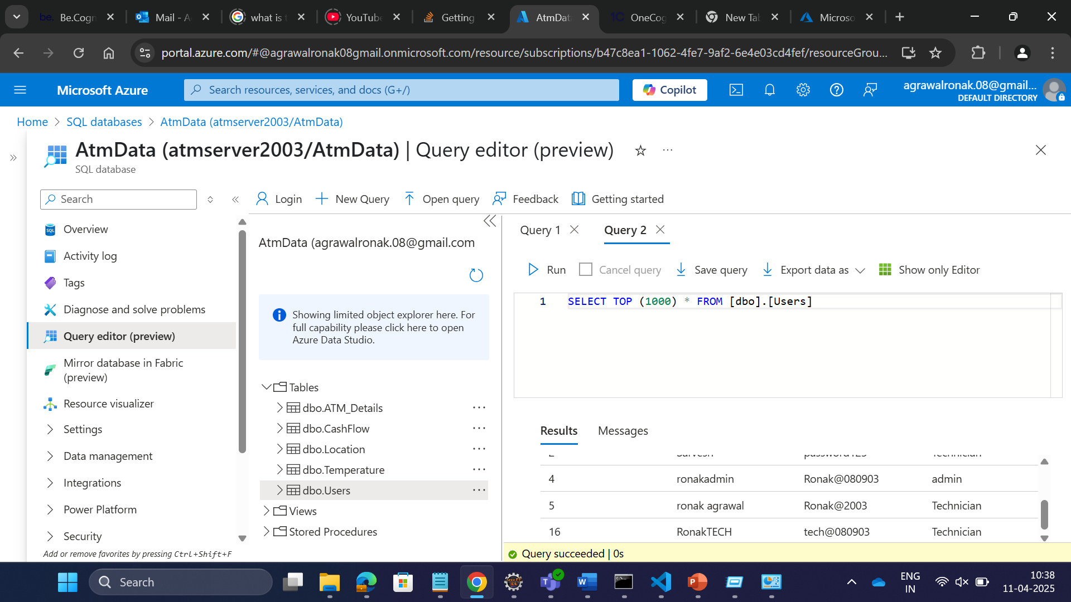

Slide 21
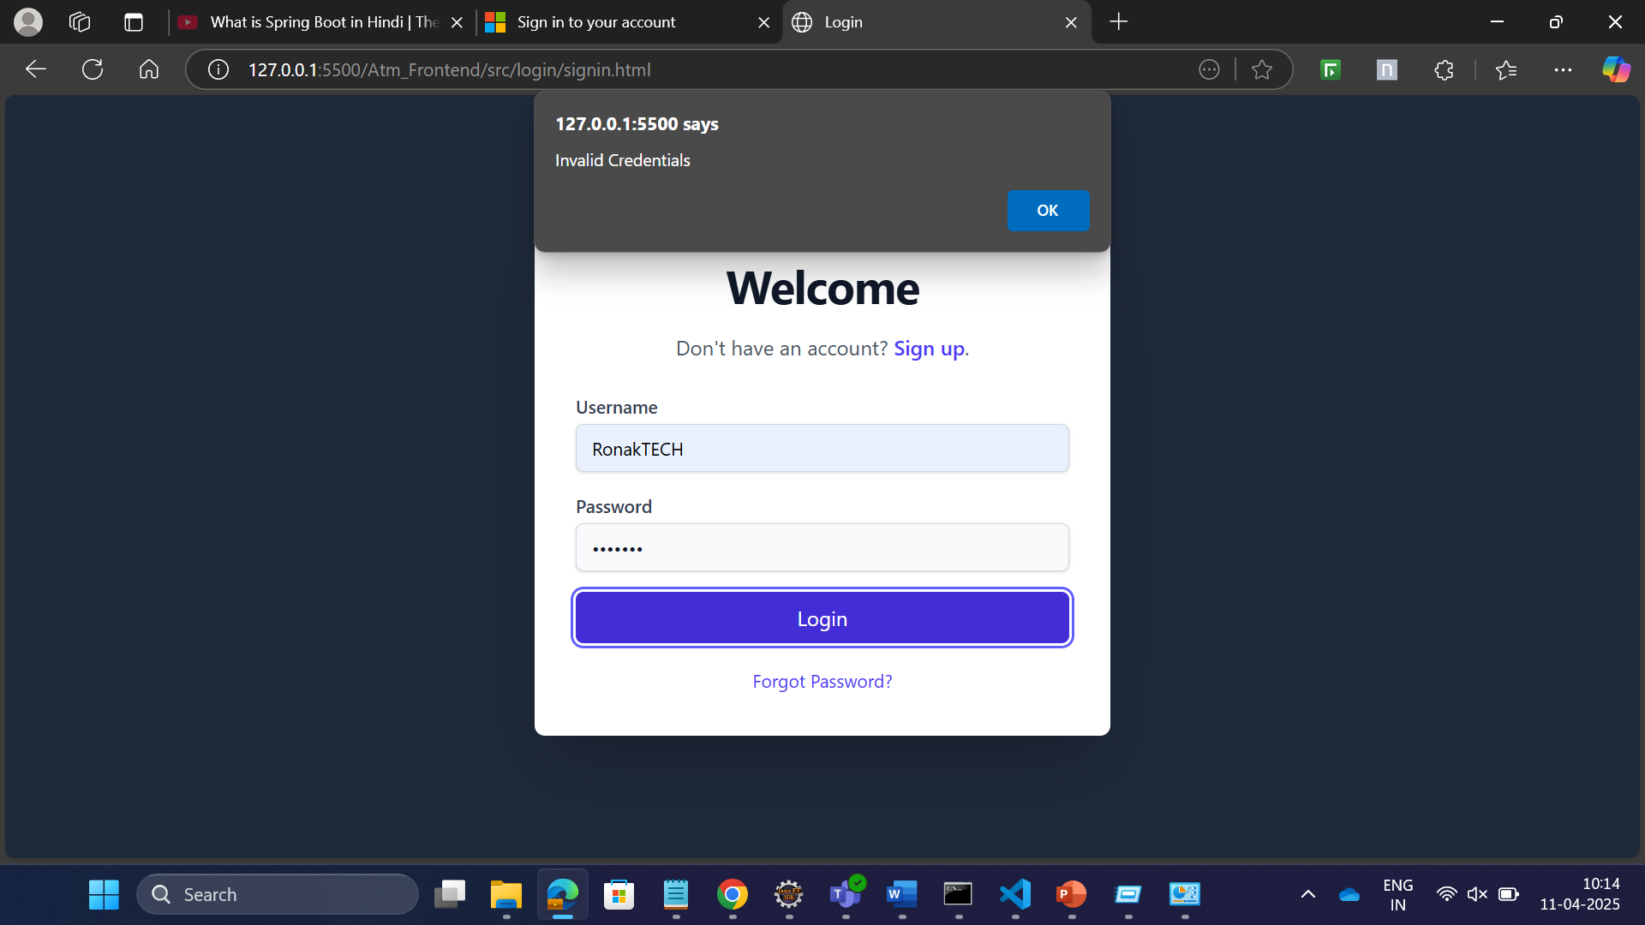

Slide 22
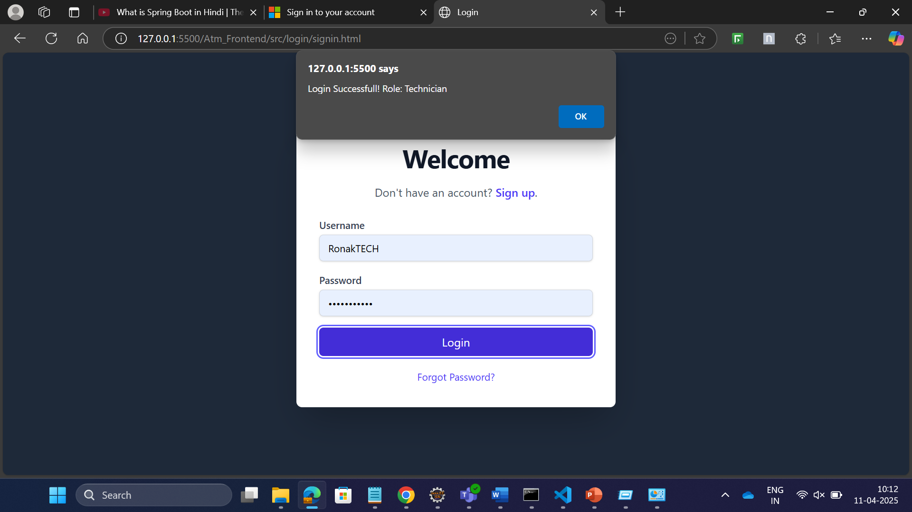

Slide 23
Features and Users Role:
User Roles:-
Technician:
Access to message sending UI.
Sends test data to IOT devices .
Views latest on the dashboard.
Admin:
Views latest data on the dashboard.

Slide 24
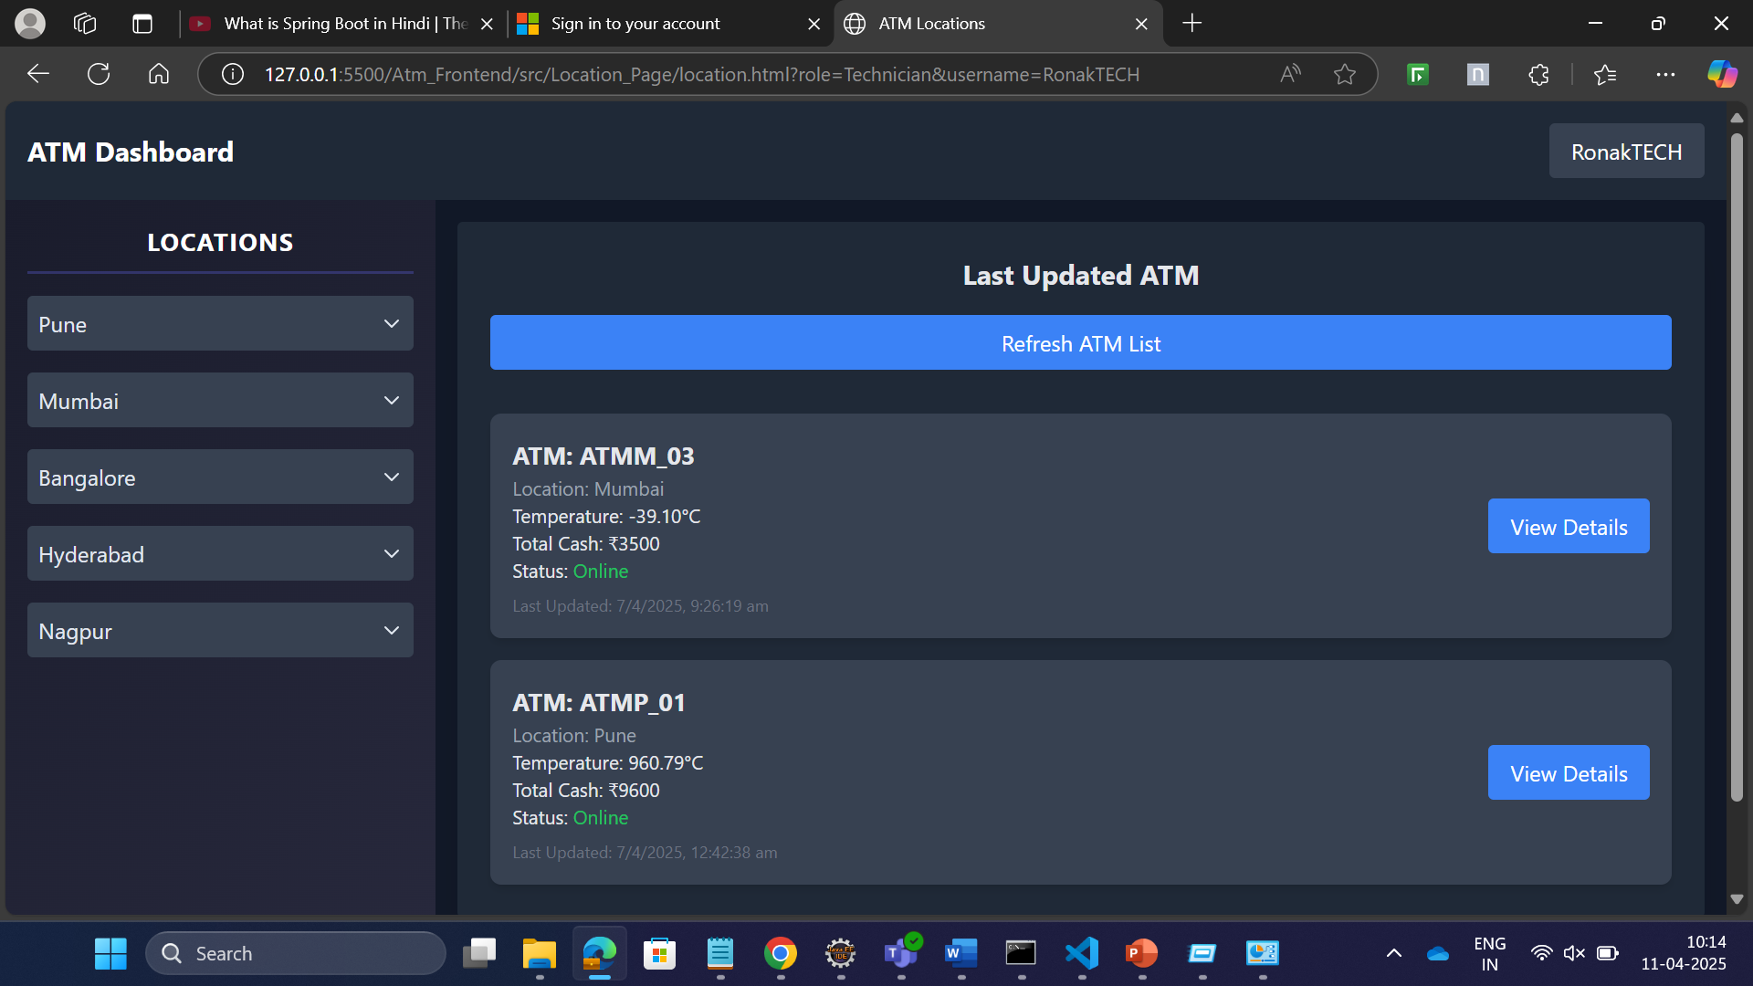

Slide 25
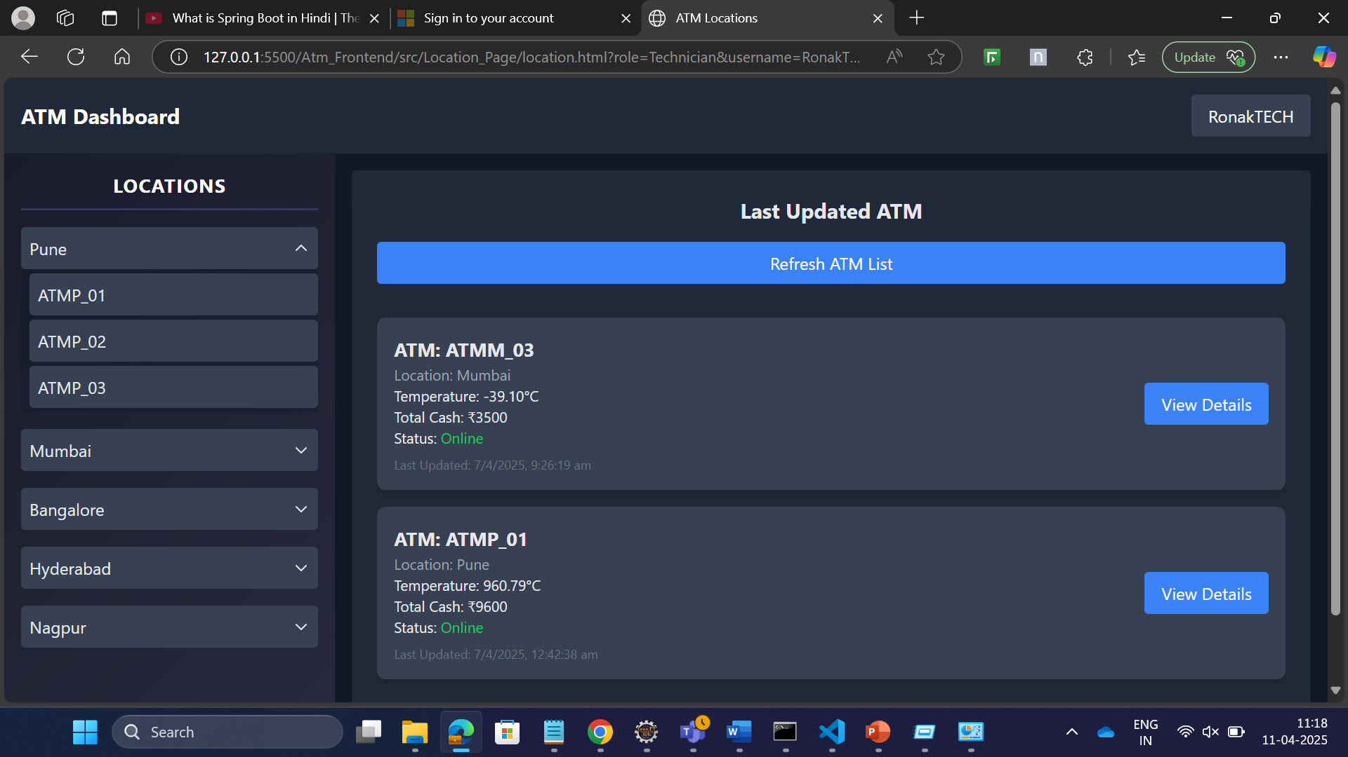

Slide 26
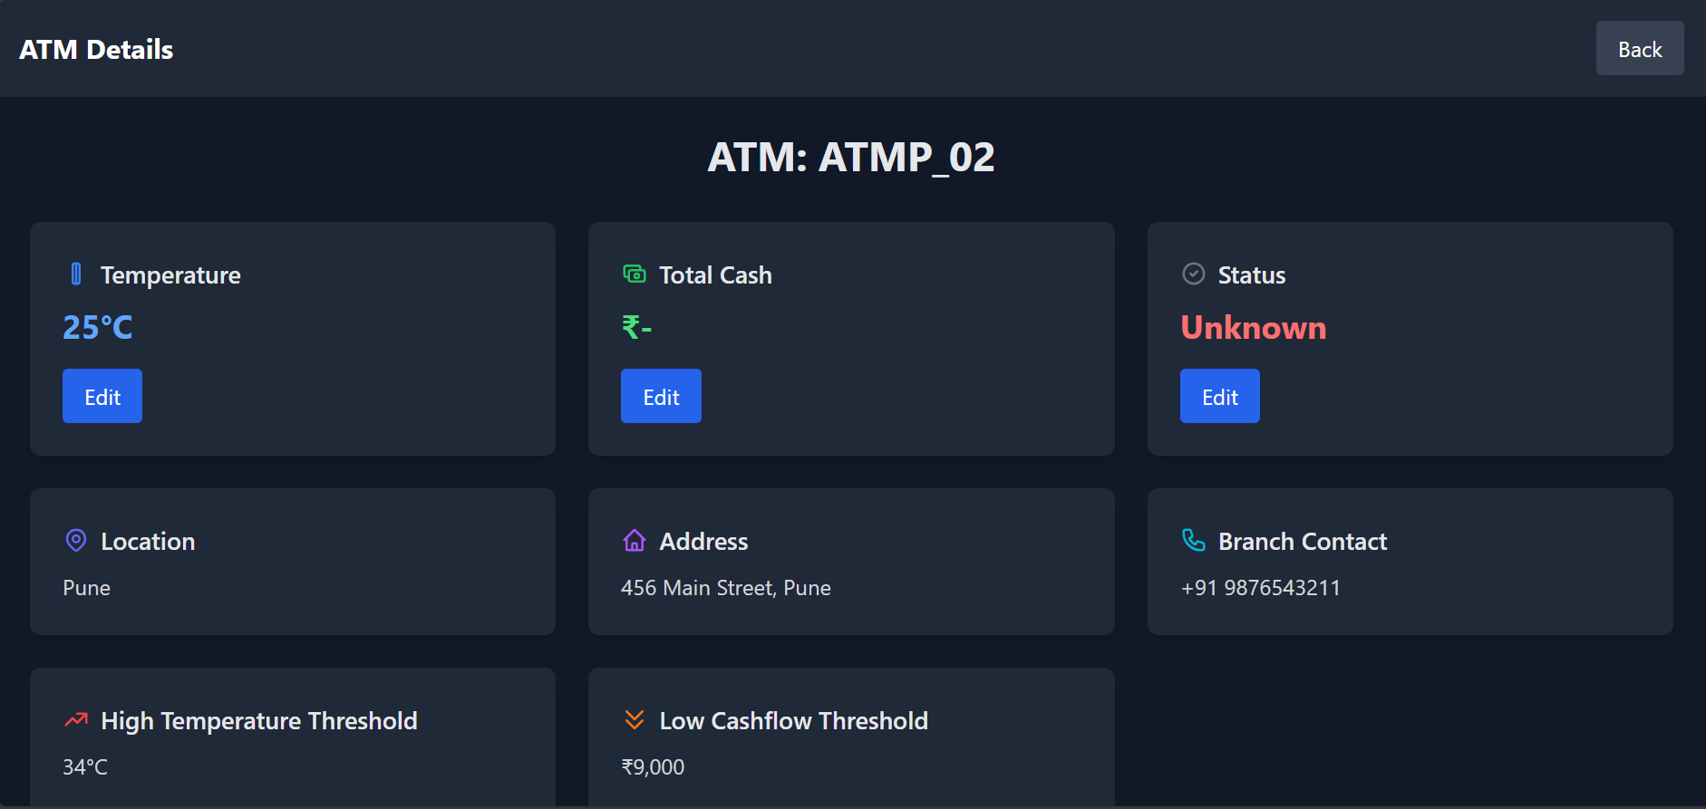

Slide 27
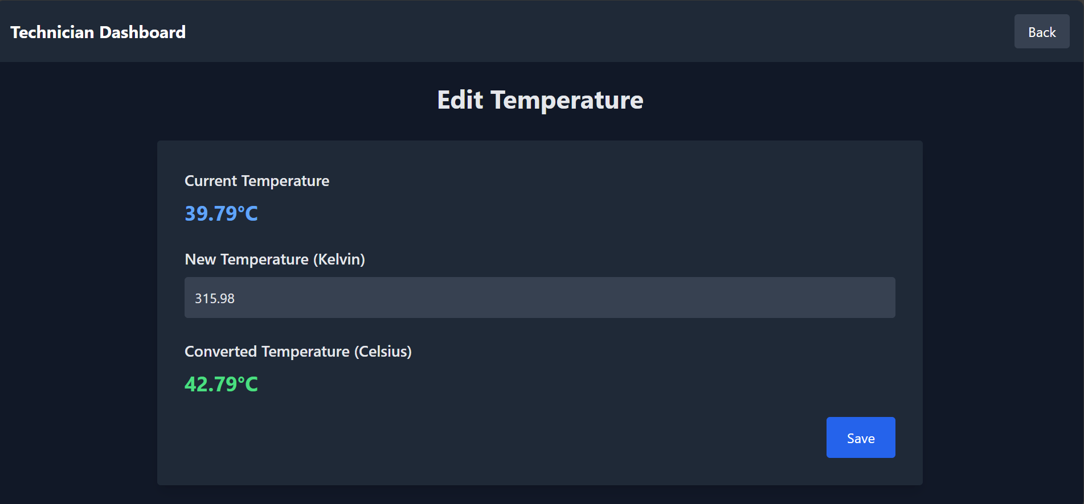

Slide 28
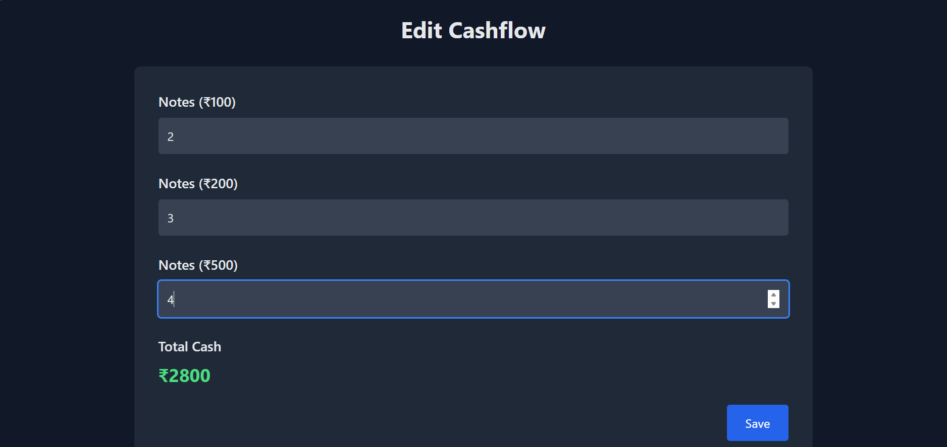

Slide 29
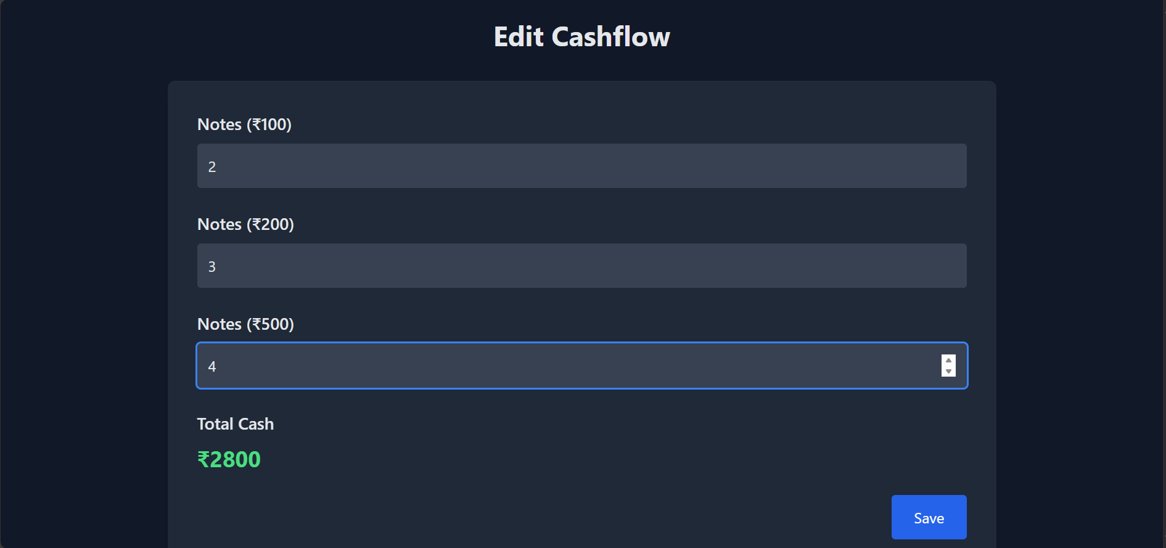

Slide 30
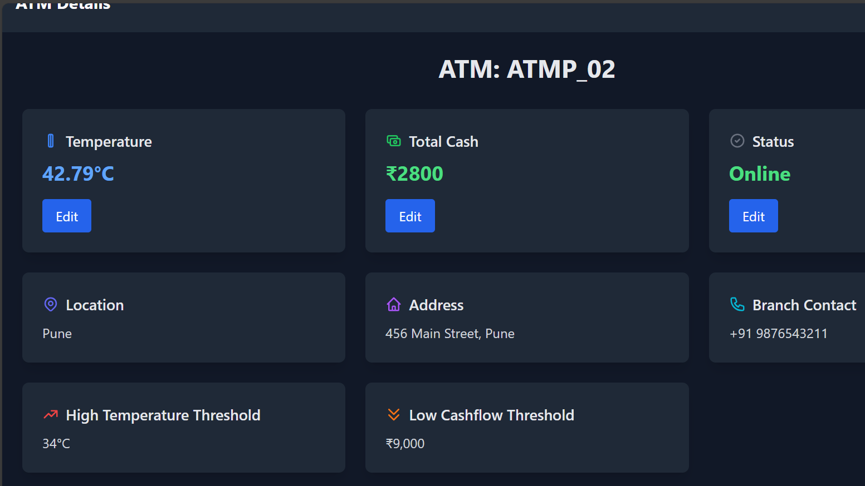

Slide 31
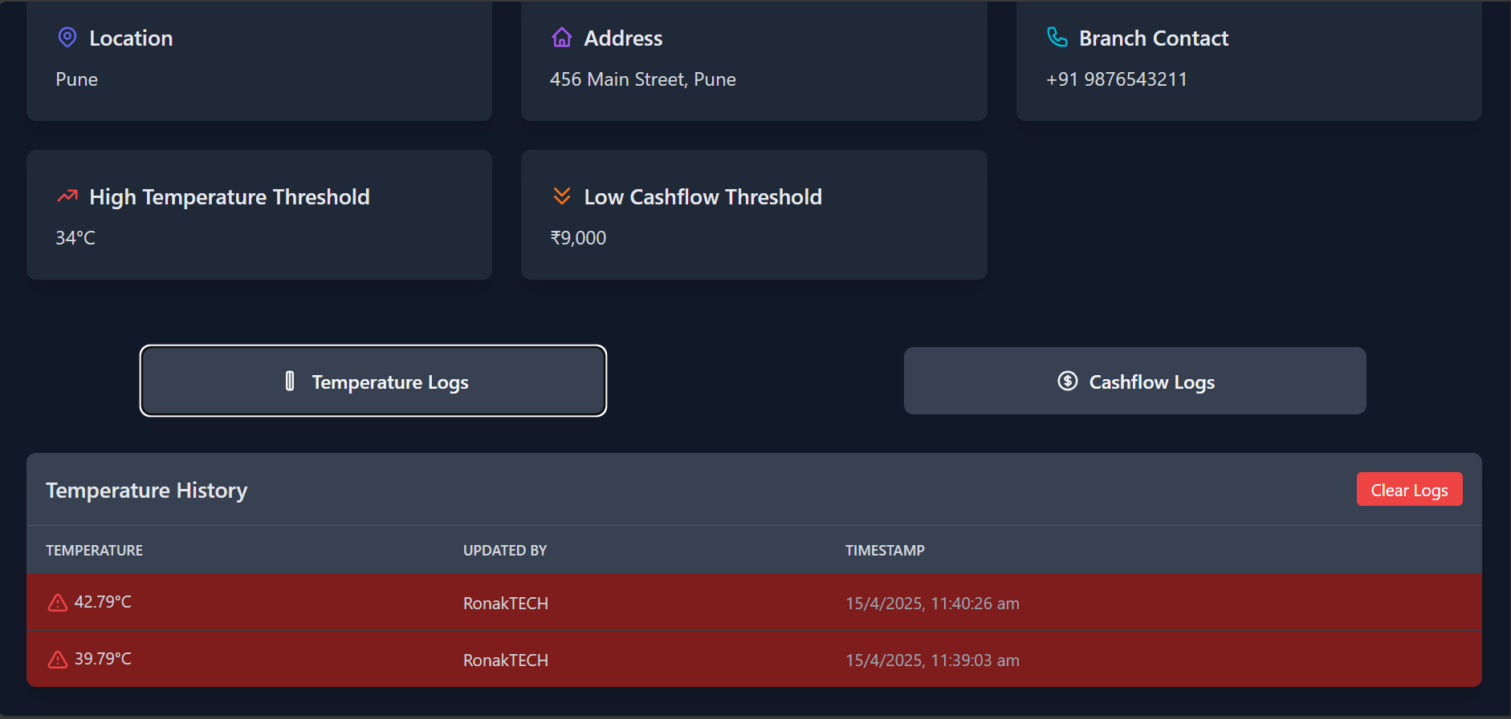

Slide 32
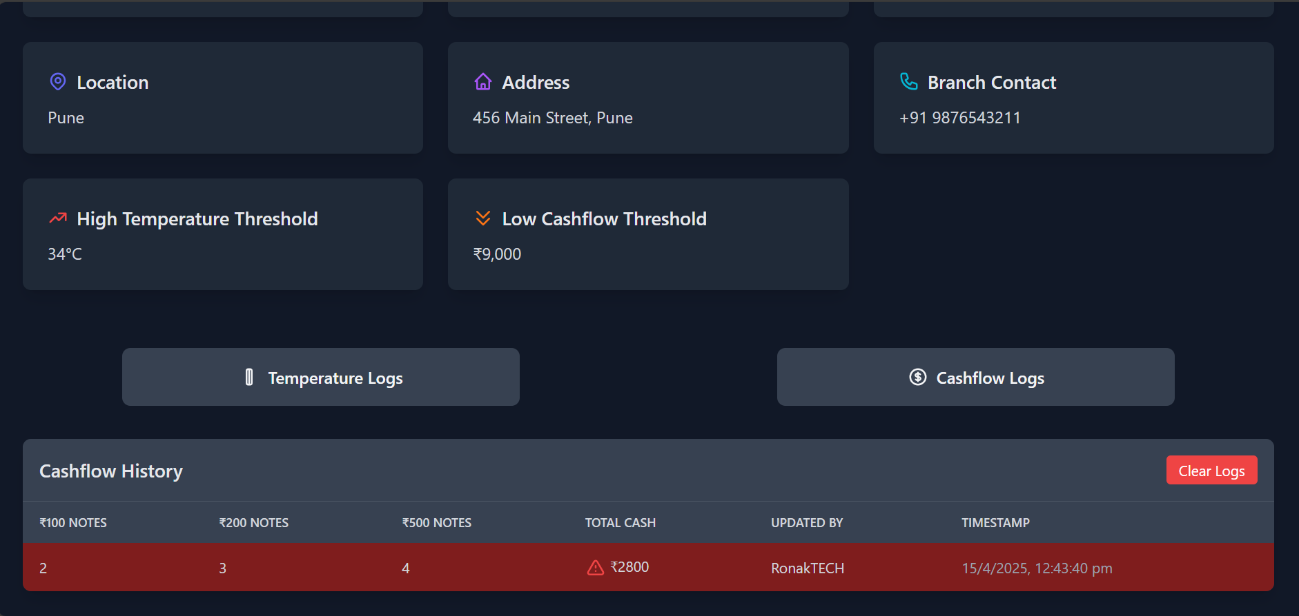

Slide 33
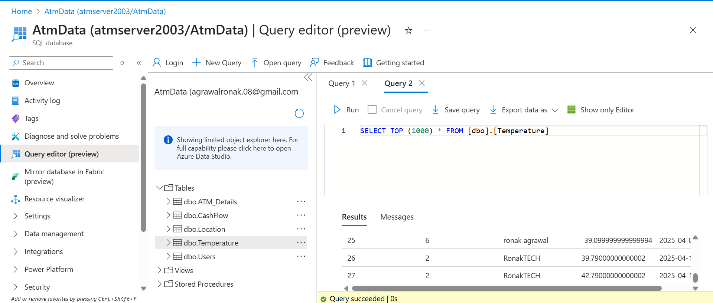

Slide 34
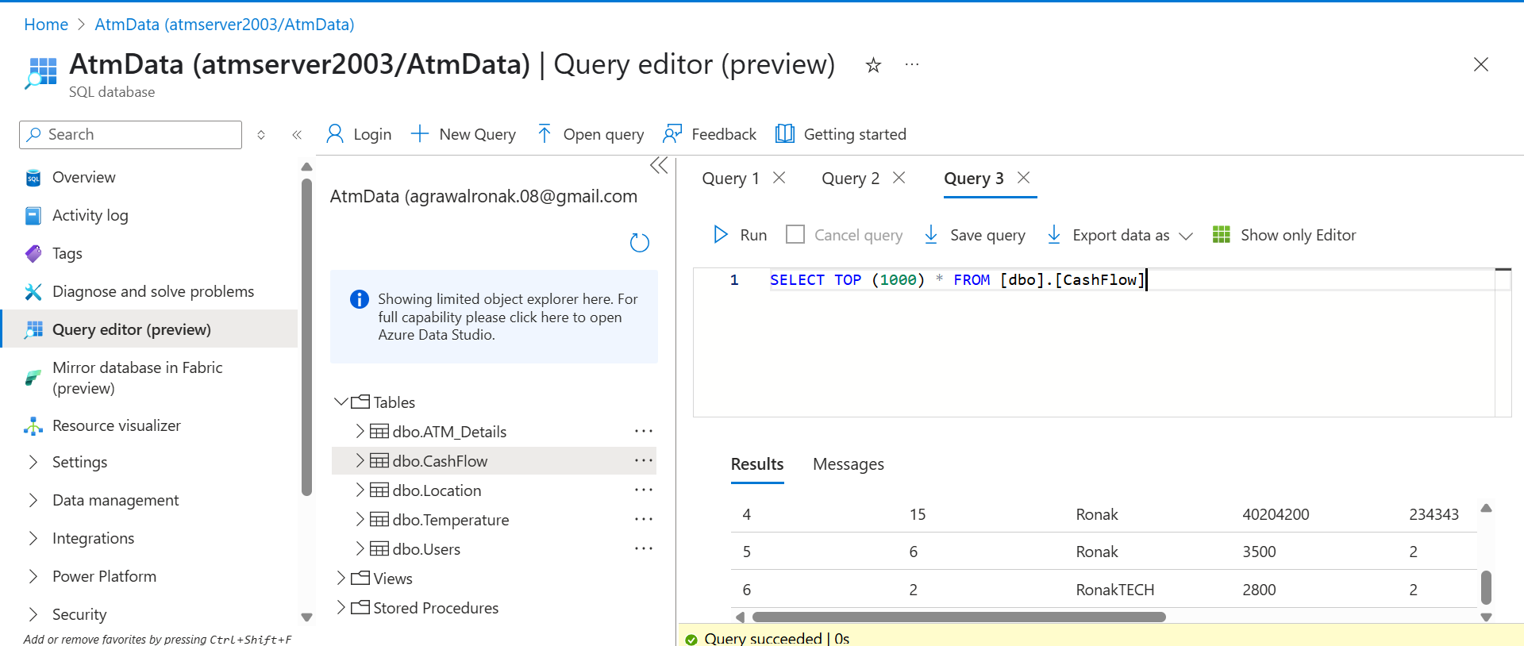

Slide 35
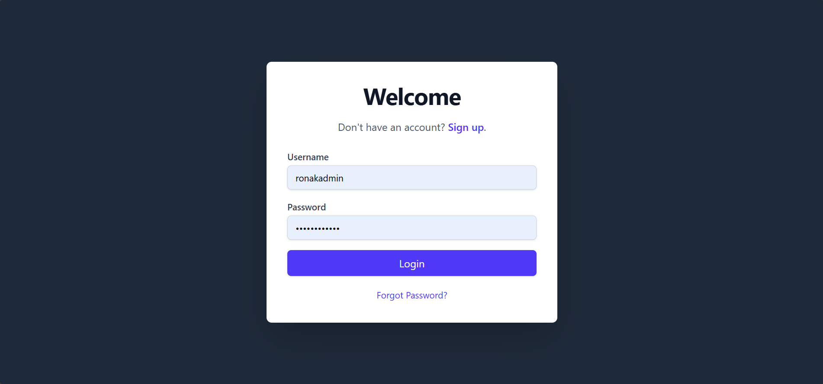

Slide 36
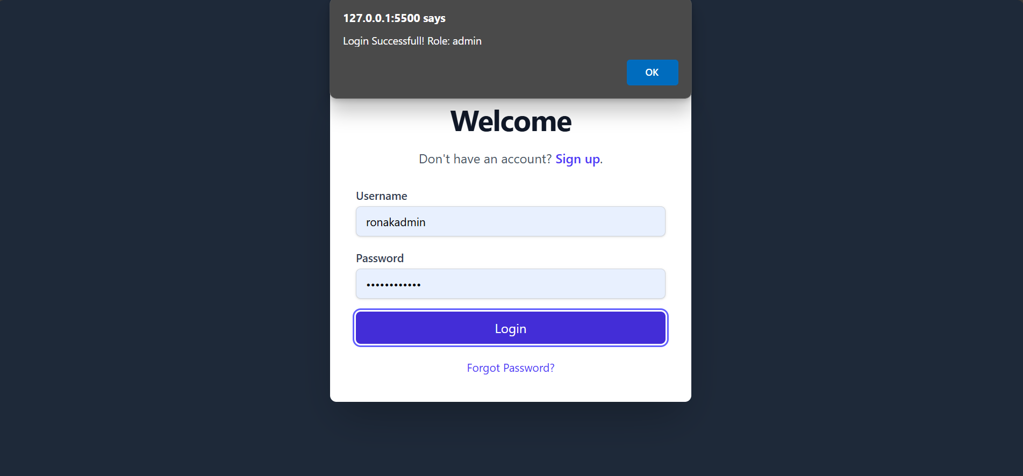

Slide 37
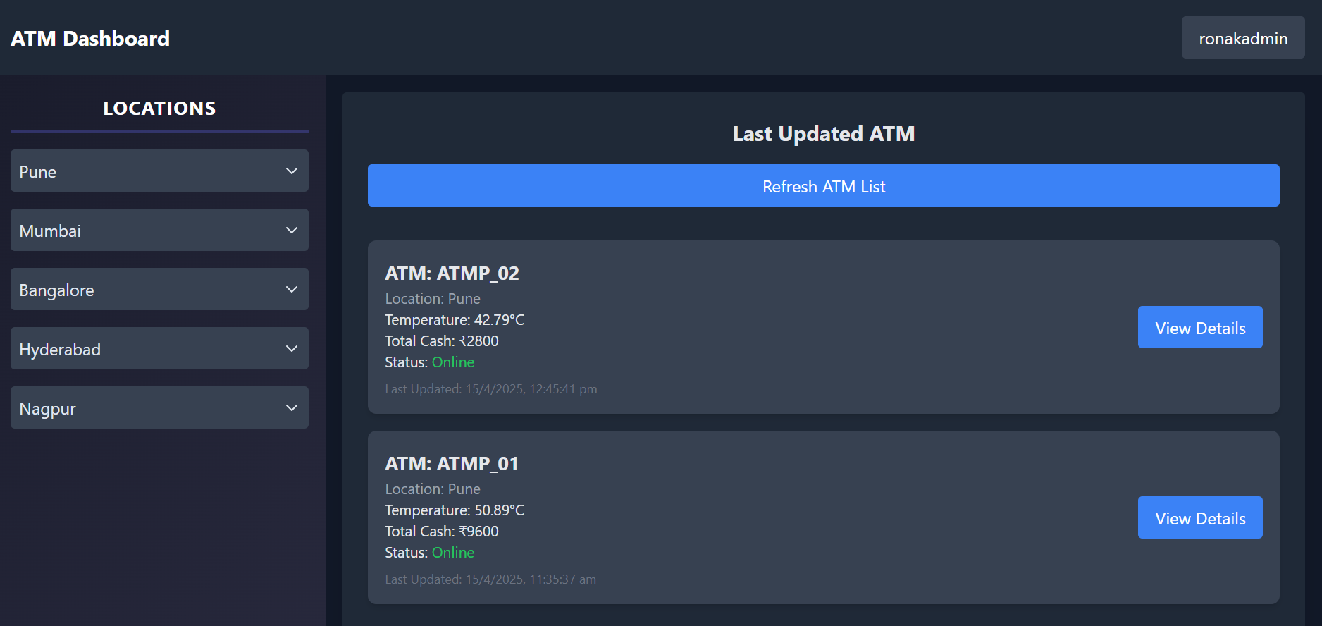

Slide 38
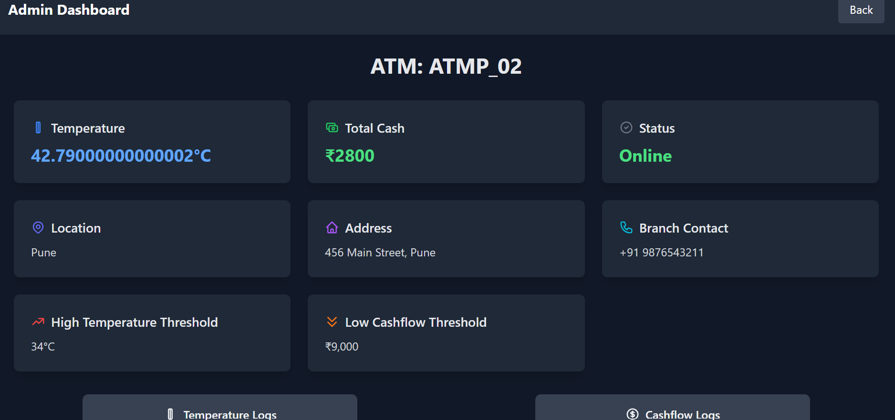

Slide 39
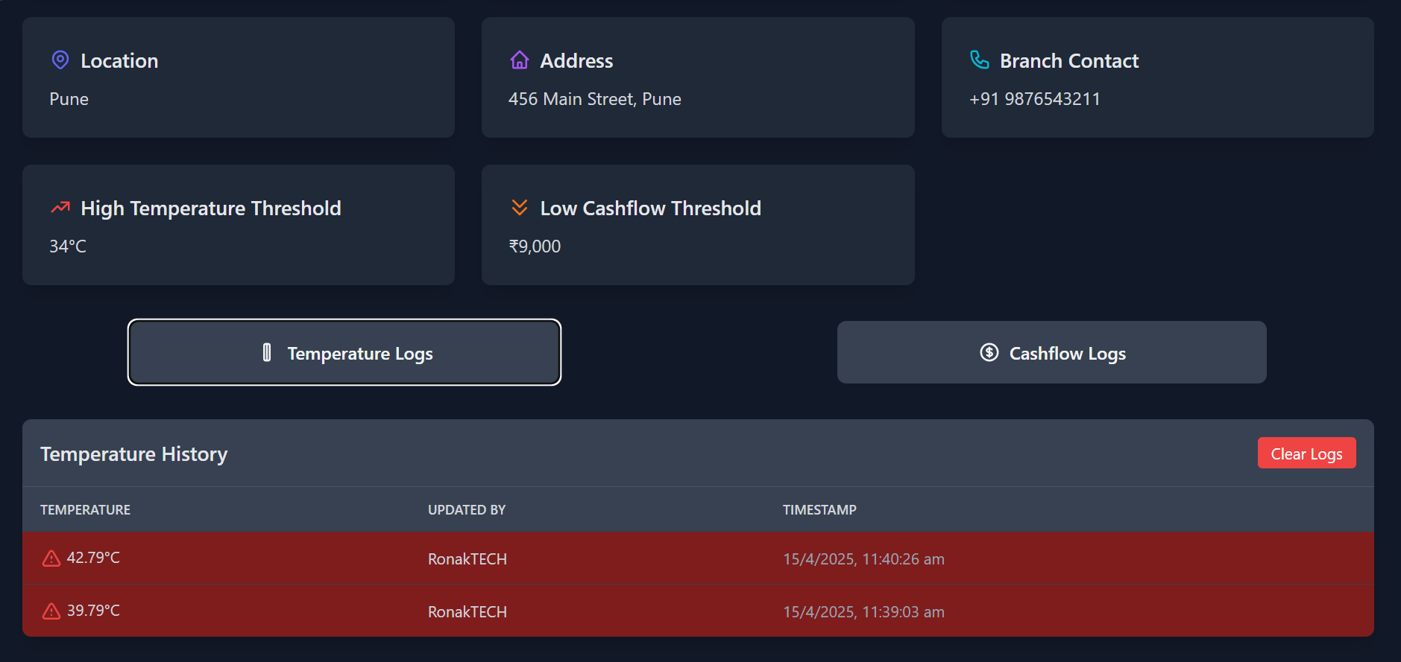

Slide 40
